Slide 1






WELCOME
Teacher: Dang Quang Vinh

Slide 2
MỤC ĐÍCH: Sau bài học này học sinh có thể hiểu và thực hành câu bị động ở hiện tại,tương lai (khiếm khuyết) và cấu trúc BE + ADJ + TO V; ADJ + MỆNH ĐỀ

Slide 3
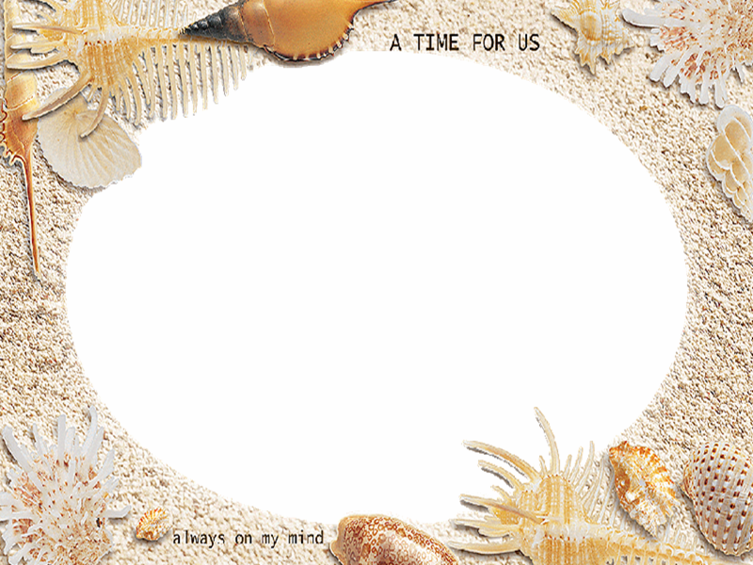
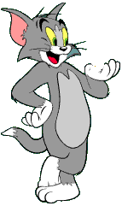

UNIT 10: RECYCLING
LESSON: LANGUAGE FOCUS
KIM'S GAME

Slide 4
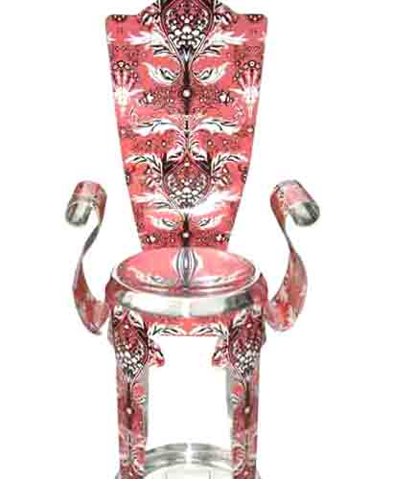
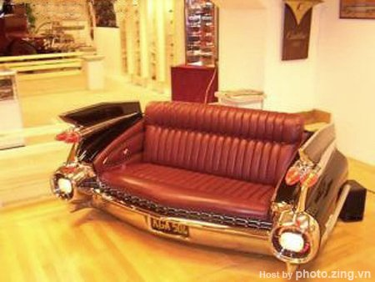
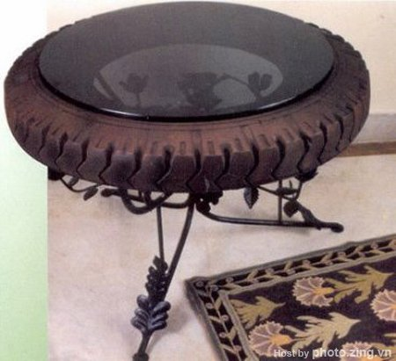

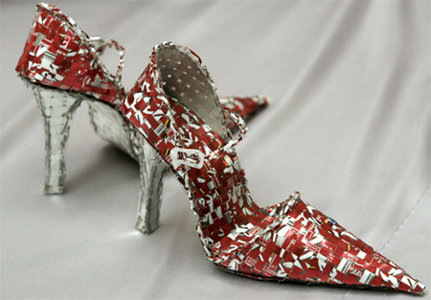

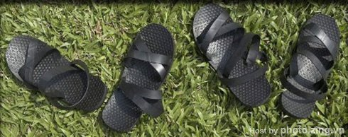
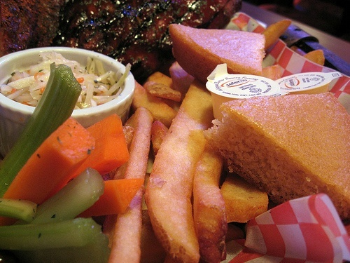

Slide 5
chair
cans
couch/sofa
shoes
table
bottles
bag
sandals
vegetable matter

Slide 6
QUESTIONS AND ANSWERS:
What do people do
with empty cans ?
People bring the cans back for recycling.

Slide 7
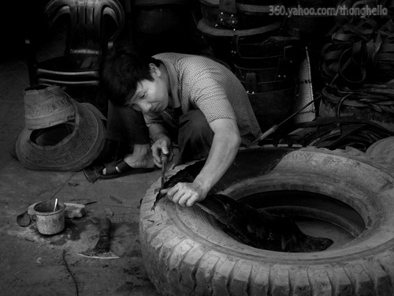
QUESTIONS AND ANSWERS:
2. What do they do
with car tires ?
They make shoes or sandals
from car tires.

Slide 8

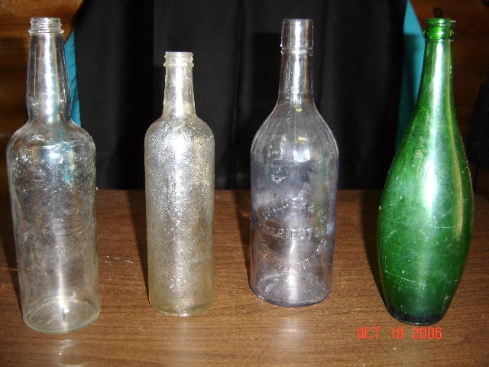
QUESTIONS AND ANSWERS:
3. What do they do
with empty bottles?
They clean and refill
the empty bottles.

Slide 9

QUESTIONS AND ANSWERS:
1. What do people do with empty cans ?
2. What do they do with car tires ?
3. What do they do with empty bottles?
People bring the cans back for recycling.
They make shoes or sandals from car tires.
They clean and refill the empty bottles.

Slide 10

UNIT 10: RECYCLING
LESSON: LANGUAGE FOCUS
1. Passive form in the present simple :
* New words:
- liquid (n):
Chất lỏng
(Water is a liquid.)

Slide 11


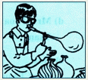
UNIT 10: RECYCLING
LESSON: LANGUAGE FOCUS
1. Passive form in the present simple :
* New words:
- blow – blew – blown (v):
thổi

Slide 12



UNIT 10: RECYCLING
LESSON: LANGUAGE FOCUS
1. Passive form in the present simple:
* New words:
- detergent(n):
chất để tẩy rửa
(This is a detergent liquid)

Slide 13




UNIT 10: RECYCLING
LESSON: LANGUAGE FOCUS
1. Passive form in the present simple:
* New words:
- dip (v):
nhúng

Slide 14

UNIT 10: RECYCLING
LESSON: LANGUAGE FOCUS
1. Passive form in the present simple:
* New words:
* Matching:
Detergent
Liquid
Blow
Dip

Slide 15



UNIT 10: RECYCLING
LESSON: LANGUAGE FOCUS
1. Passive form in the present simple:
* New words:
* Matching:
* Grammar structure:
ACTIVE:
The mouse chases the chicken.
S
V
O
PASSIVE:
The chicken
is chased
by
the mouse.
S
BE + P.P
O

Slide 16
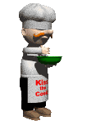
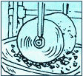
UNIT 10: RECYCLING
LESSON: LANGUAGE FOCUS
1. Passive form in the present simple:
* New words:
* Matching:
* Grammar structure:
* Model sentence:
ACTIVE:
Break the glass into small pieces.
V
O
The glass is broken into small pieces.
PASSIVE:
S
BE + P.P
(AM, IS, ARE)

Slide 17

TASK 1:
Read a guide on how to recycle glass. Look at the instructions, rewrite
them in the passive form and put the pictures in the correct order.
b) Then wash the glass with a detergent liquid.
V
O
c) Dry the glass pieces completely.
V
O
d) Mix them with certain specific chemicals.
V
O
e) Melt the mixture until it becomes a liquid.
V
O
f) Use a long pipe, dip it into the liquid, then
blow the liquid into intended shapes.
V
O
V
O
V
O

Slide 18

ĐÁP ÁN
a) The glass is broken into small pieces.
b) Then the glass is washed with a detergent liquid.
c) The glass pieces are dried completely.
d) They are mixed with certain specific chemicals.
e) The mixture is melted until it becomes a liquid.
f) A long pipe is used, it is dipped into the liquid, then the liquid is blown into intended shapes.

Slide 19
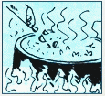
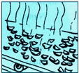
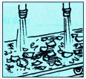
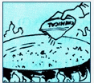
Put the pictures in the correct order
1
2
3
4
5
6

Slide 20
Pictures in the correct order
1
4
3
5
2
6

Slide 21




UNIT 10: RECYCLING
LESSON: LANGUAGE FOCUS
1. Passive form in the present simple tense:
2. Passive form in the future simple tense:
* Model sentence:
(+) The project will be started very soon.
S
WILL BE + P.P
S + will be + p.p
(-) The project won’t be started very soon.
(?) Will the project be started very soon ?

Slide 22

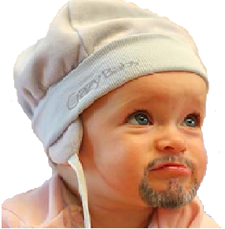
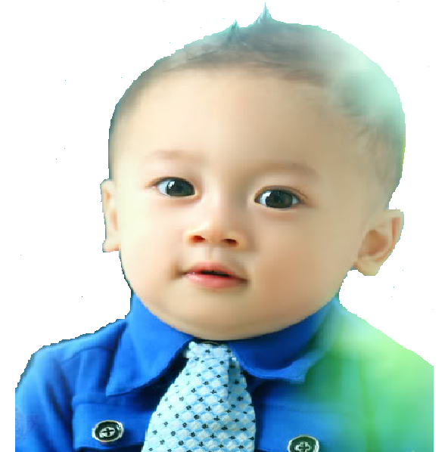

When will the
project be
started, Doctor?
Very soon.
Dr.Kim
Hai
The project will be started very soon.

Slide 23
Task 2
A famous inventor, Dr. Kim, is going to build a time machine. One of his assistant, Hai, is asking him questions about the invention.
Complete the dialogue. Use the correct form of the verbs in brackets.
Hai: When (0) will the project be started, Doctor ? (start)
Dr. Kim: Very soon.
Hai : Many people want to see the time machine.
Dr. Kim: Yes. It (1) to the public when (show)
it is finished.
Hai : (2) it by the end of the year, Doctor? (build)
Dr. Kim: I’m afraid not, but it (3) before Tet. (finish)
Hai : (4) it by you ? (make)
Dr. Kim: No, I need you to build it . When can you start ?
Hai: Let’s begin tomorrow.
Will be shown
Will
be built
will be finished
Will
be made

Slide 24
UNIT 10: RECYCLING
LESSON: LANGUAGE FOCUS
1. Passive form in the present simple tense:
2. Passive form in the future simple tense:
3. An adjective followed by an infinitive:
* Model sentence:
Ba: Turn right, then left, then right and then left again.
Nam:It your directions.
Can you start again, please?
is difficult to follow
It + be + adjective + to - infinitive

Slide 25
Task 3
Complete the dialogue. Use the words in the box. Bài tập này các bạn áp dụng cấu trúc BE + ADJ + TO V
easy / understand dangerous / go difficult / follow hard / believe important / wait
a) Ba: Turn right, then left, then right and then left again.
Nam: It’s ( 0) difficult to follow your directions.
Can you start again, please?
b) Mr. Dao: Can you do the exercise, Hoa?
Hoa: Yes, Mr. Dao. It’s (1)
c) Lan: In the future, mankind might live on the moon.
Nga: Really? It’s (2)
d) Mrs. Thoa: Stop, Tuan ! It’s (3) near the stove.
Tuan : Sorry, Mom.
e) Hoa: Should I stir the mixture, Aunt Thanh?
Aunt Thanh: No. It’s (4) for five minutes.
easy to understand.
hard to believe.
dangerous to go
important to wait

Slide 26


UNIT 10: RECYCLING
LESSON: LANGUAGE FOCUS
1. Passive form in the present simple tense:
2. Passive form in the future simple tense:
3. An adjective followed by an infinitive:
4. An adjective followed by a noun clause:
New words:
- relieved (a):
nhẹ nhõm
≠
worried (a)

Slide 27





4. An adjective followed by a noun clause:
New words:
- Congratulations: (n)
Xin chúc mừng
Nam: I passed my exam, Grandma.
Grandma: Congratulations!

Slide 28
4. An adjective followed by a noun clause:
New words:
- look forward to (v):
trông chờ
- confirm (v):
xác nhận lại
.
.
.
.
.
.
Password:
.
.
.
.
.
.
Confirm your password:

Slide 29

4. An adjective followed by a noun clause:
New words:
Jumbled words
KOLO WARDFOR OT
LOOK FORWARD TO
NIMFCRO
CONFIRM
RGACOTINLOSNUA
CONGRATULATIONS
DERVELEI
RELIEVED

Slide 30
4. An adjective followed by a noun clause:
* New words:
* Jumbled words
* Model sentence:
Your grandfather and I are delighted that you passed your English exam.
S
be
adj
noun clause
S + be + adjective + noun clause

Slide 31

Task 4
Complete the letter. Use the correct forms of the verb be and the adjectives in the box.
Dear Nam,
Your grandfather and I (0) are delighted that you passed your English exam. Congratulations!
Aunt Mai (1)__________ that you remembered her birthday last week. She told me you gave her a beautiful scarf.
I (2) _________ that your mother is feeling better. Please give her my love.
We’re looking forward to seeing you in June. However, grandfather
(3) ______ that the day is wrong. (4)___ you ____ that you are arriving on Saturday 20th ?
I (5) ________ that there are no trains from Ha Noi on Saturday.
Write soon and confirm your arrival date and time.
Love,
Grandma
happy delighted certain relieve sure afraid
was happy
am relieved
is afraid
Are
sure
am certain

Slide 32
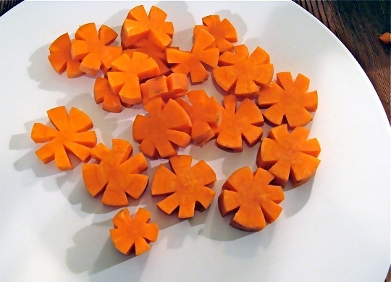

1.CHUYỂN SANG CÂU BỊ ĐỘNG NHÉ
Cut the carrots into small flowers.
The carrots are cut into small flowers.
2.
I will build a robot next year
A robot will be built next year.

Slide 33
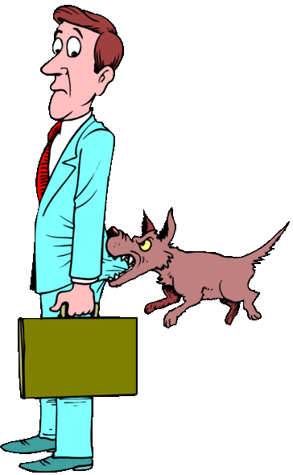

3.ÁP DỤNG CẤU TRÚC BE + ADJ + TO V
dangerous / go near a dog.
It’s dangerous to go near a dog.
4.
Choose the correct answer.
The boy is very ________ that everyone likes him.
A. Love B. lovely C. loving D. to love
lovely

Slide 34
BÀI TẬP CÂU BỊ ĐỘNG
1. People grow rice in many countries in the world.
-> Rice ______________________________________
2. Graham Bell invented the telephone many years ago.
-> The telephone ______________________________
3. Lan practices English every day.
-> English ____________________________________
4. They will take the garbage out of the city.
-> The garbage _____________________________
5. Mary sent me this letter two days ago.
-> I _________________________________________
6. People make compost from vegetables.
-> Compost ____________________________________
7. They clean the floor every morning.
-> The floor ____________________________________
8. We planted many trees in the school garden.
-> Many trees _________________________________
9. Lan bought some comic books for her brother .
-> Some comic books ..........................................................
10. My sister received a letter yesterday .
-> A letter ............................................................................

Slide 35
Homework:
Learn by heart all newwords

Slide 36

GOODBYE !

